Slide 1

UltraSonic Sensor + OLED Screen
· COMPUTER SCIENCE PRESENTATION ·
SKYLER NAHOURAY AND EDWIN SANTIAGO

Slide 2

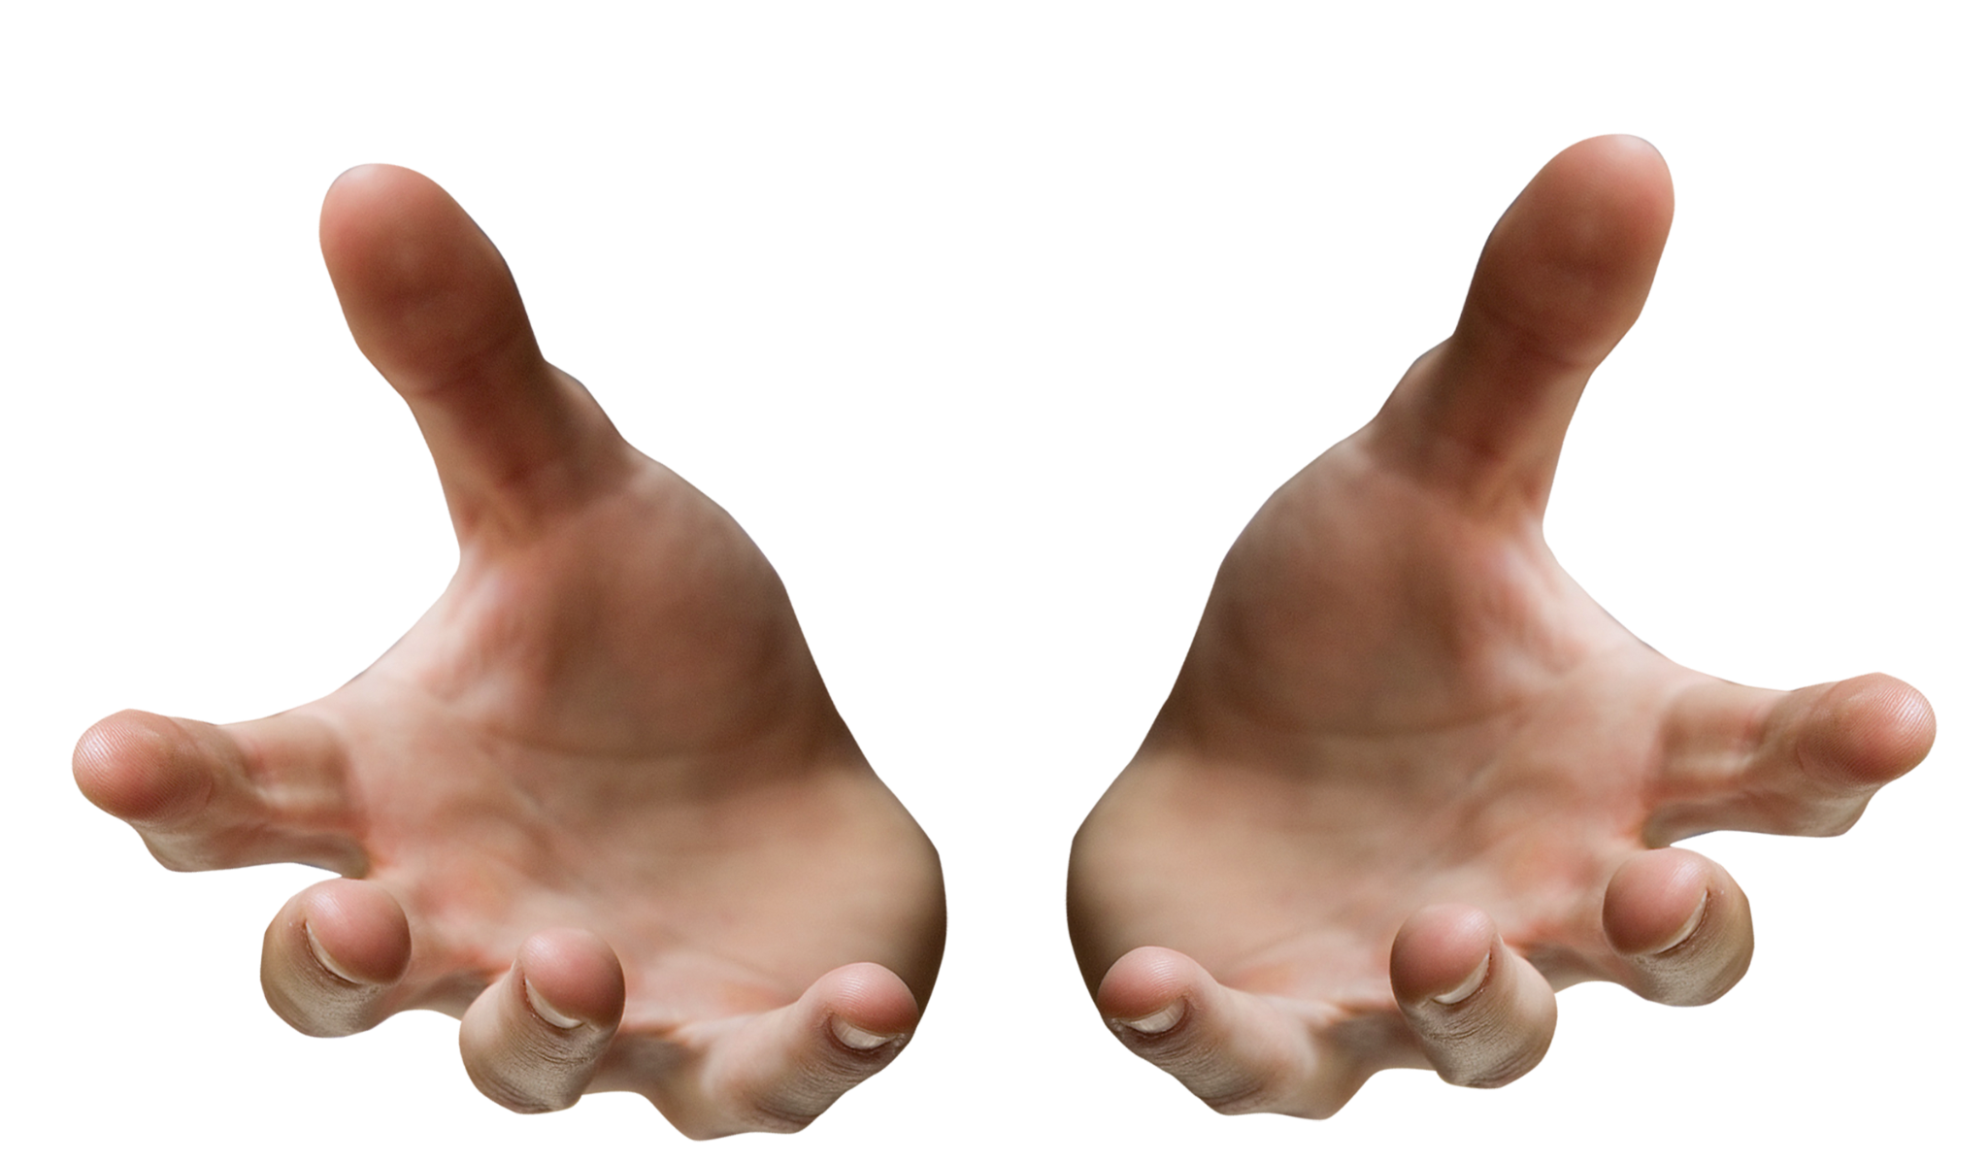
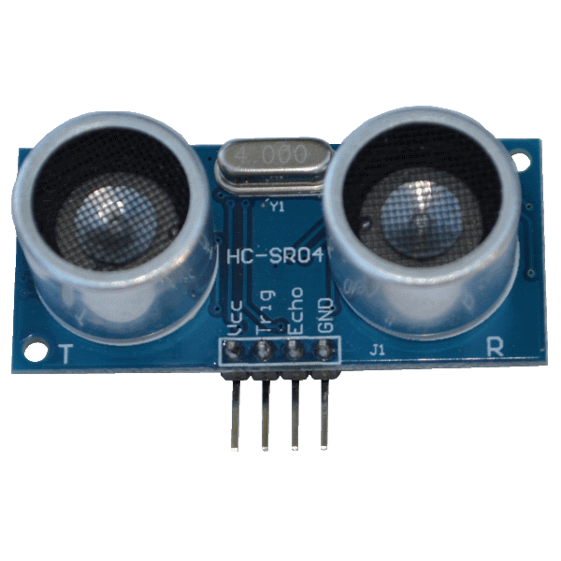

Slide 3
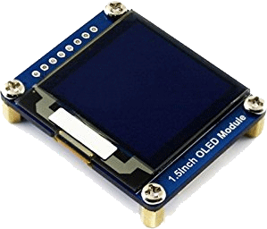

Slide 4
We have combined an UltraSonic Sensor and an OLED Screen (Normal Size). According to Arduino Get Started, “OLED (Organic Light-Emitting Diode) is an alternative for LCD display. The OLED is super-light, almost paper-thin, flexible, and produces brighter and crisper picture [quality].” “Ultrasonic sensors work by emitting sound waves at a frequency too high for humans to hear. They then wait for the sound to be reflected back, calculating distance based on the time required. This is similar to how radar measures the time it takes a radio wave to return after hitting an object” (Arrow).

Slide 5
WHOA!
Did you know that as you move your hand/object around, the number projected on the OLED Screen changes accordingly?

Slide 6

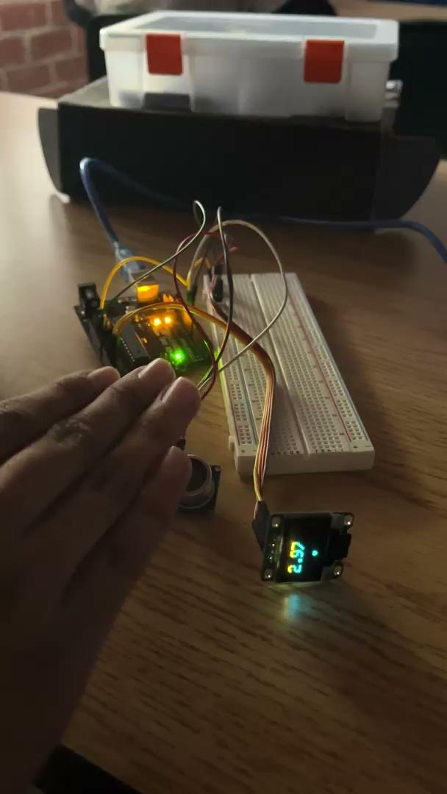
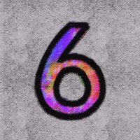
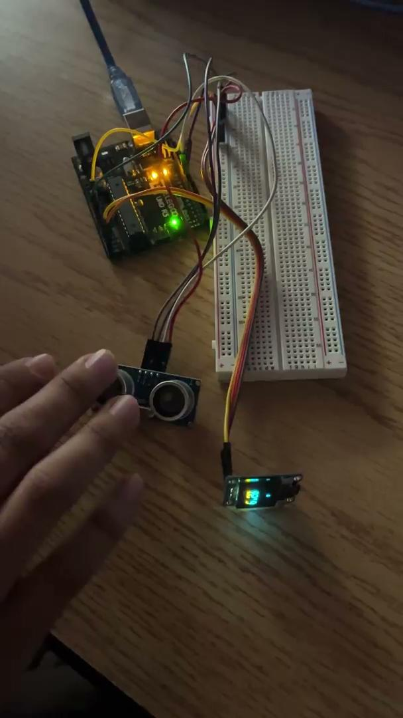
These quick videos show how Edwin’s hand causes the Ultrasonic Sensor to wait for the sound waves to be reflected back, resulting in a variation of numbers displayed on the OLED screen.

Slide 7

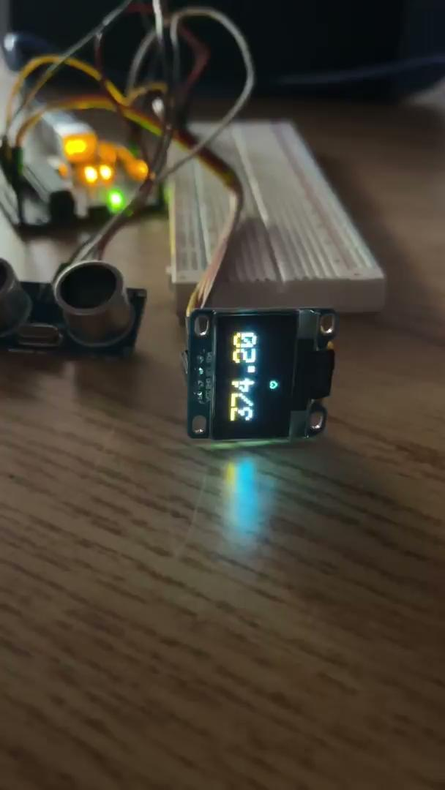
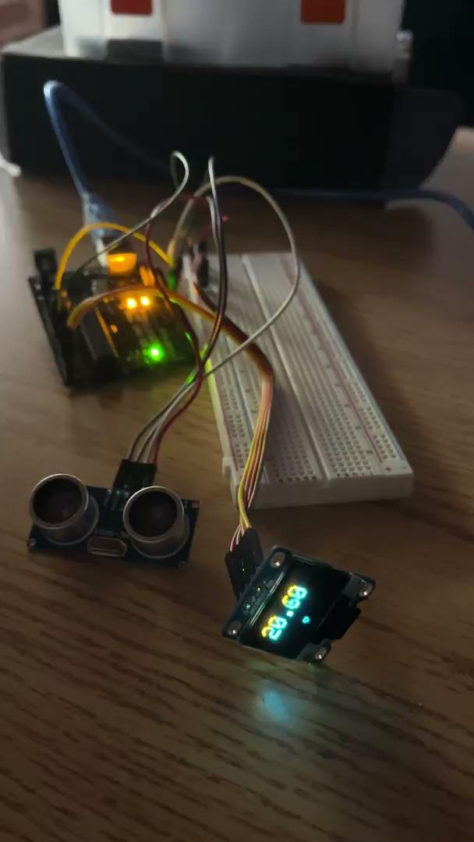
MORE
VIDEOS

Slide 8

/*
*/
#include <Adafruit_GFX.h>
#include <Adafruit_SSD1306.h>
Adafruit_SSD1306 display(128, 64);
const int trigPin = 9;
const int echoPin = 10;
float duration, distance;
const int heart[] = {
0, 1, 1, 0, 0, 1, 1, 0,
1, 0, 0, 1, 1, 0, 0, 1,
1, 0, 0, 0, 0, 0, 0, 1,
1, 0, 0, 0, 0, 0, 0, 1,
0, 1, 0, 0, 0, 0, 1, 0,
0, 0, 1, 0, 0, 1, 0, 0,
0, 0, 0, 1, 1, 0, 0, 0,
0, 0, 0, 0, 0, 0, 0, 0
};
First Part of Code
This Part consists of the Library and defining the pins of the Ultrasonic Sensor. The Last cluster is the code for the Sprite which makes the heart shapes at the bottom of the OLED.

Slide 9
VOCAB BREAK
Sprite - a computer graphic which may be moved on-screen and otherwise manipulated as a single entity. In other words, they are the objects that perform actions in a project. While the Stage can also be programmed in a project, most projects have at least one sprite as well because only sprites can move.

Slide 10
void drawSprite(int xpos, int ypos, int width, int height, int arr[]) {
int y = 1;
int x = 0;
int count = 0;
for (int i = 0; i < width * height; i++) {
count ++;
x++;
if (count > width) {
count = 1;
y++;
x = 1;
}
if (arr[i] == 1) {
display.drawPixel(x + xpos, y + ypos, WHITE);
}
}
}
Second Part of Code
This Part consists of the function that draws the Sprite. It is going through an array. Thus, defining the x and y variables.

Slide 11
void setup() {
delay(100);//delay to avoid problems
pinMode(trigPin, OUTPUT);
pinMode(echoPin, INPUT);
Serial.begin(9600);
display.begin(SSD1306_SWITCHCAPVCC, 0x3c);
display.clearDisplay();//clears previous things
display.dim(0);//max brightness
}
void loop() {
display.clearDisplay();//clears previous things
digitalWrite(trigPin, LOW);
delayMicroseconds(2);
digitalWrite(trigPin, HIGH);
delayMicroseconds(10);
digitalWrite(trigPin, LOW);
duration = pulseIn(echoPin, HIGH);
distance = (duration * .0343) / 2;
display.setTextSize(3);
display.setTextColor(WHITE);
display.setCursor(12, 10);
display.println(distance);
Serial.println(distance);
Third Part of Code
This Part consists of setting up all of the pins to be correct and setting up the coordinated display. Duration and Distance are in play for the UltraSonic Sensor and recording and analyzing the pulses. The last cluster is for printing on the OLED screen and controlling text size, cursor, color, and location.

Slide 12
Fourth Part of Code
drawSprite(60, 50, 8, 8, heart);
drawSprite(80, 50, 8, 8, heart);
drawSprite(100, 50, 8, 8, heart);
drawSprite(40, 50, 8, 8, heart);
drawSprite(20, 50, 8, 8, heart);
drawSprite(20, 80, 8, 8, heart);
display.display();
delay(5);
}
This Part consists of drawing the hearts and the delay is preventing the program from crashing.

Slide 13
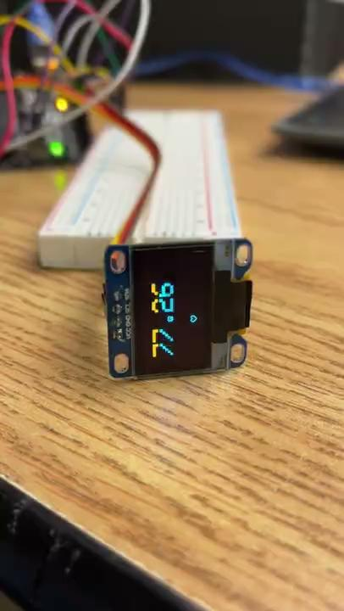
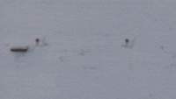
FINAL PRODUCT

Slide 14
SOURCES
https://create.arduino.cc/projecthub/abdularbi17/ultrasonic-sensor-hc-sr04-with-arduino-tutorial-327ff6
https://www.arrow.com/en/research-and-events/articles/ultrasonic-sensors-how-they-work-and-how-to-use-them-with-arduino
https://thestempedia.com/encyclopedia/sprite/

